Slide 1
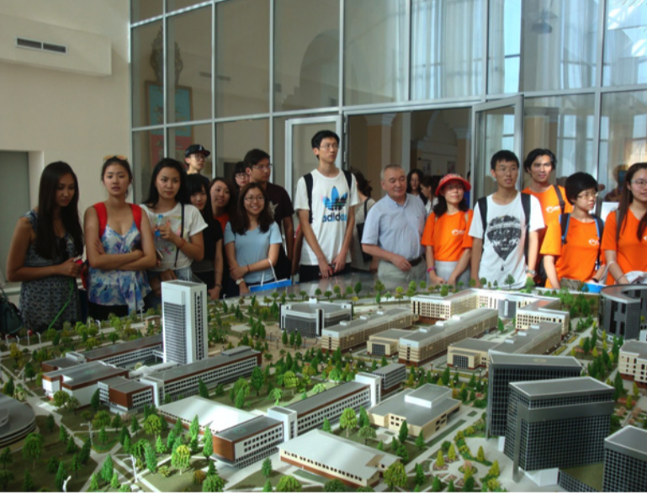
XVII ASIAC Annual Conference
The Priorities of Sustainable Development of al-Farabi KAZNU:
Green University, Green Office, Green Campus
Ibrayeva Galiya
Al-Farabi Kazakh National university
Sapienza University of Rome
14-16 Decrmber, Roma

Slide 2
Content of Research
The Al-Farabi Kazakh National University is one of the leaders in Green Universities
”Green Office’
”Green Campus”
United Nations Academic Impact (UNAI) program and Al Farabi KazNU
“Green Bridge through Generation”
Columbia University MDP / Global Classroom

Slide 3


Slide 4
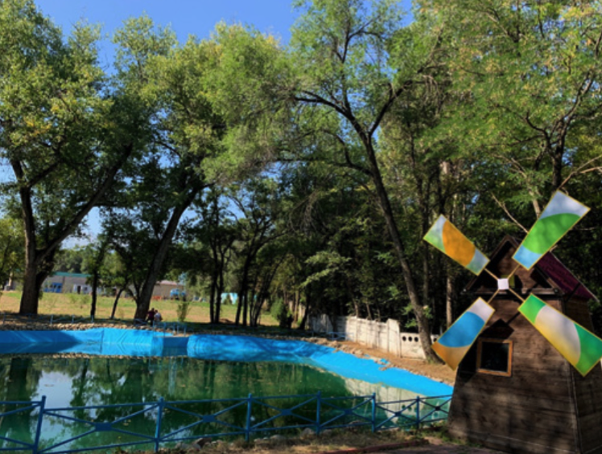

Slide 5


Slide 6
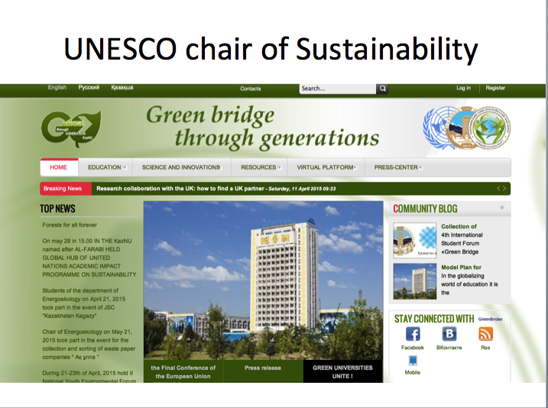

Slide 7
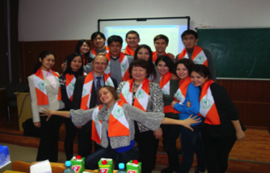
The Research
1..Inclusion of sustainable development issues in the university curricula.
2. Building the current activities of the university on the principles of sustainable development
3. Creation of opportunities for students and university staff to acquire skills of socially responsible behavior
4. Formation of a favorable environment, creation of a “green campus”.
.

Slide 8
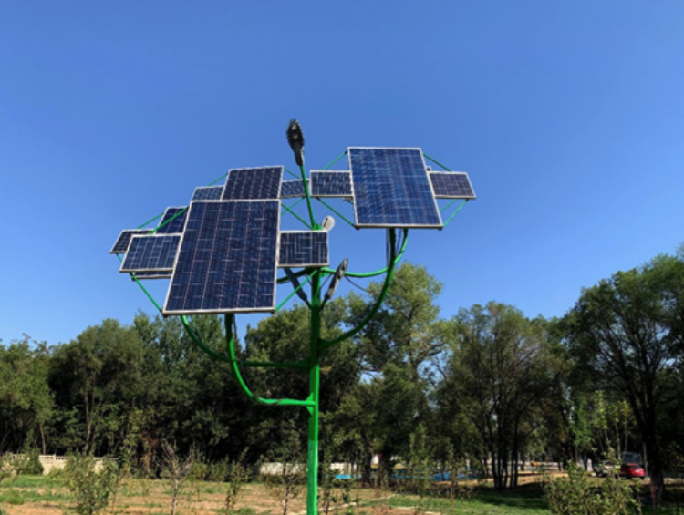
The concept of a “green university”
01
02
03
04
“Green University”
includes holding positive eco-events,
improving energy efciency, introducing eco-educational programs,
landscaping and landscaping, introducing “green” technologies,
organizing a separate waste collection system and other areas.
Kazakhstan
Kyrgyzstan
Tajikistan
Uzbekistan

Slide 9
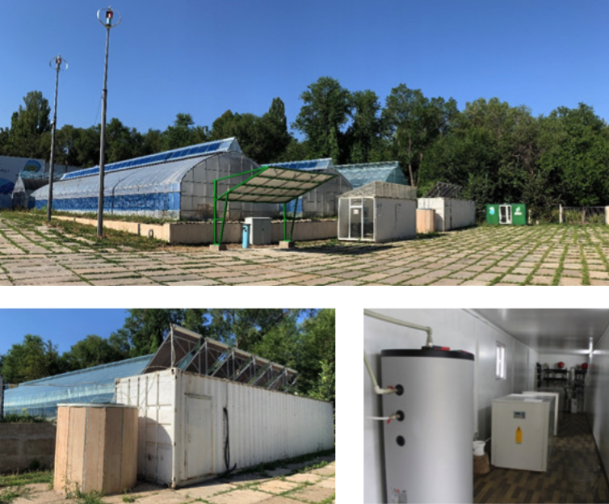
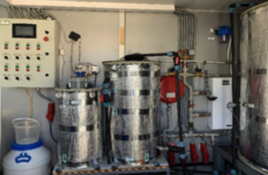
Concept “green office”
Kyrgyzstan
Kazakhstan
Uzbekistan
Tajikistan
31.5%
24.3%
23.5%
20.7%

Slide 10

The philosofy of the “green office”

Slide 11
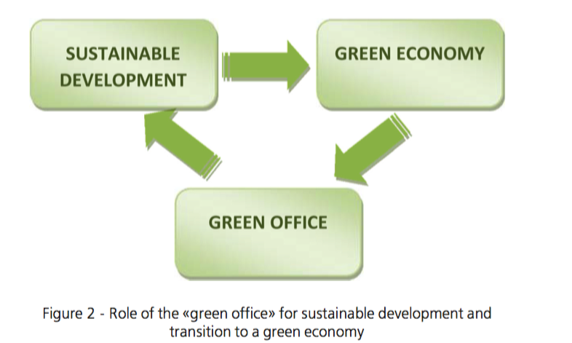

Slide 12
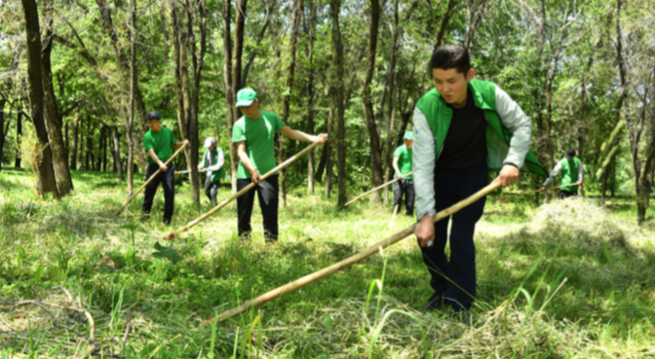
Concept “Green Campus”
Reduction
Refineme
Replacement
In total, 1,572 women and 2,558 men were interviewed
Women interviewed
the proportion of women in the entire sample was 38%
Kazakhstan - 57%
Kyrgyzstan - 40%
Tajikistan- 24%
Uzbekistan - 28%,

Slide 13
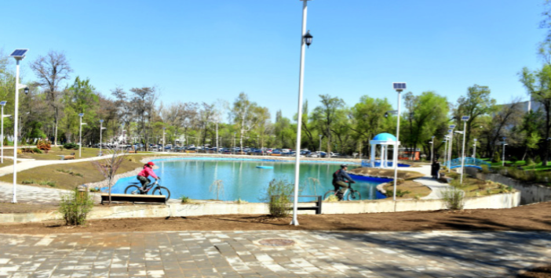
KazNU Green Campus

Slide 14
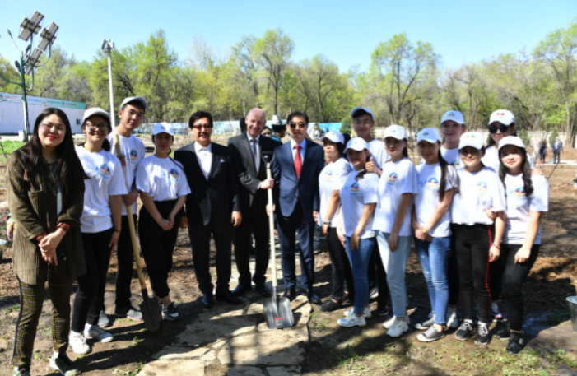
Students’ climate action for “Planting Apple Trees”
. The main goal, the development of the most efficient methods of using energy and resources, as well as the restoration of natural ecosystems with high biodiversity

Slide 15
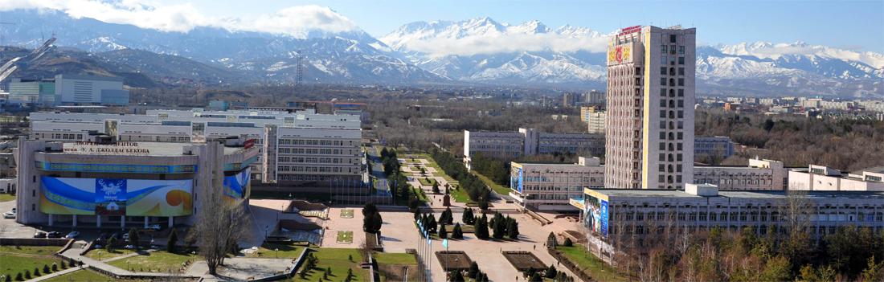
Thbaks fo

Slide 16
THANK YOU
FOR YOUR ATTENTION!

