Slide 1
Modern Methodology of Foreign Language Education
Lecture 1: Approaches and Methods in Foreign Language Teaching

Slide 2
Main issues
What is a method?
What are the components of a method?
What is an approach?
Overview of most well known methods in language teaching.
Do methods help teachers?
Problems with methods.
Is there a super method?

Slide 3
What is a method?

Slide 4
What is a method?
All methods include prescriptions for the teacher and the learners.
All methods are a pre-packaged set of specifications of how the teacher should teach and how the learner should learn derived from a particular theory of language and a theory of language learning.

Slide 5
What is a method? (2/2)
For the teacher, methods prescribe what materials and activities should be used, how they should be used and what the role of the teacher should be.
For learners, methods prescribe what approach to learning the learner should take and what roles the learner should adopt in the classroom.

Slide 6
What is an approach?

Slide 7
What is an approach? (1/1)
Underlying each method is a theory on the nature of language and a theory on the nature of language learning both of which comprise the approach.
These theories are derived from the areas of linguistics, sociolinguistics, psycholinguistics and are the source of principles and practices of language teaching.

Slide 8
What is an approach influenced by?
  Theory of language: How is language viewed?
    Structural View of Language.
    Functional View of Language.
Theory of language learning: How do learners learn the language?
      What are the psychological and cognitive processes involved (habit formation, induction, inferencing, generalization)?
      What are the conditions that need to be met for these learning processes to be activated?

Slide 9
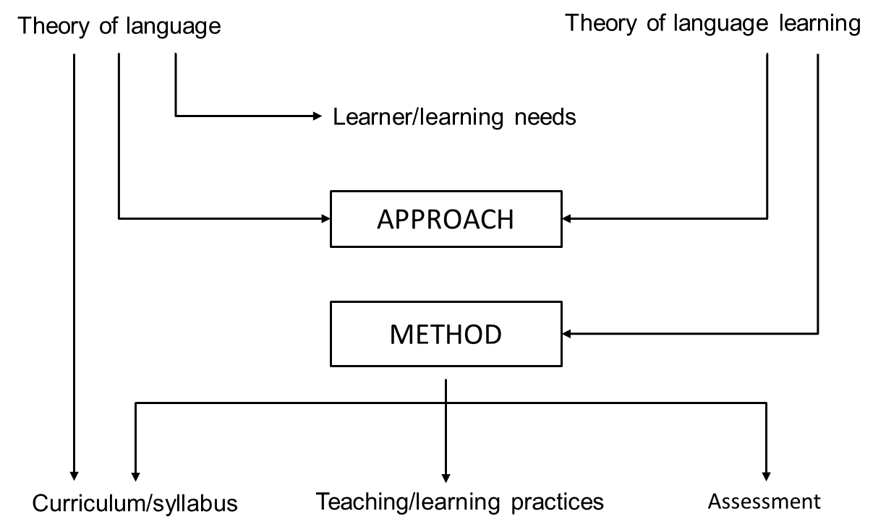
Figure 1: Foreign language didactics in the 20th century

Slide 10
Theory of language – focus of teaching (1/2)
  If language is seen as a system of structurally related elements for the coding of meaning:
    What dimension of language is prioritized?
      Grammatical dimension.
    What needs to be taught?
      Phonological units.
      Grammatical units and operations.
      Lexical items.

Slide 11
Theory of language – focus of teaching (2/2)
If language is viewed as a vehicle for the expression of functional meaning:
    What dimension of language is prioritized?
      semantic and communicative dimension of language.
    What needs to be taught?
      functions, notions of language.

Slide 12
Components of a method

Slide 13
Syllabus
Syllabus is the level at which theory is put into practice and at which choices are made about the content to be taught, the skills to be developed, the order of the content etc.
The theory of language adopted will affect the organisation and selection of language content.
Different methods have different types of syllabi associated with them i.e. different ways of selecting and organising content.

Slide 14
Teaching/Learning Practices (1/2)
Types of learning tasks and activities to be used in the classroom.
Roles of learners in the classroom: the degree of control that learners have over their learning, roles that learners will assume in the classroom, learning groupings recommended.
Roles of teachers: functions that the teacher is to fulfil in the classroom, the degree to which the teacher influences the learning process and the kind of interaction between the teacher and the learners.

Slide 15
Teaching/Learning Practices (2/2)
Role of materials: the function of materials in the learning process and the forms they take. In some methods, materials are designed to replace the teacher so that learning can take place independently. In others, materials are teacher proof so that even poorly trained teachers with imperfect control of the language can use them.

Slide 16
Assessment
How students’ language knowledge is to be assessed.
Error correction policy.

Slide 17
How do all of these relate?
Different theories about the nature of language and how languages are learned (the approach) imply different ways of teaching language (the method) and different methods make use of different kinds of classroom activities (the techniques).
techniques
method
approach

Slide 18
Figure 1: Foreign language didactics in the 20th century

Slide 19
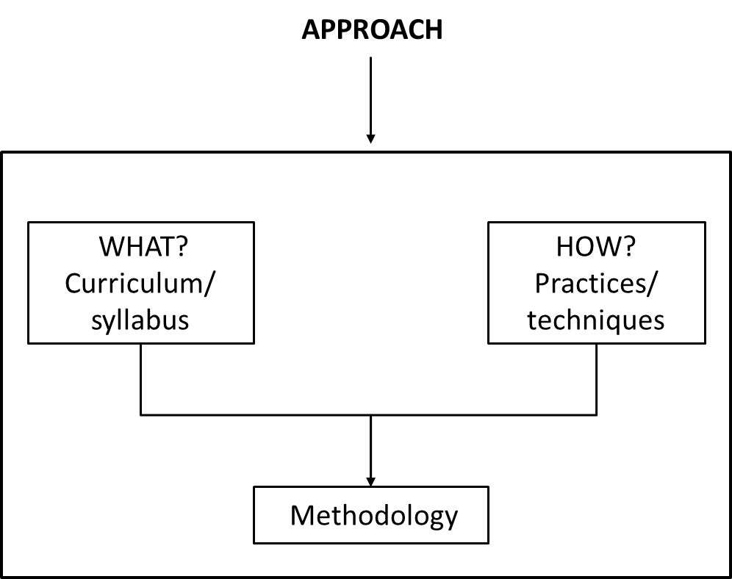
Figure 2: The relationship between approach – method.

Slide 20
Problems associated with methods (1/4)
No general agreement on what method is: Any principled choice of techniques can be termed “method”.
Some methods not based on clear language and language learning theory.
Methods are open to wide interpretation by materials developers and teachers.

Slide 21
Problems associated with methods (2/4)
Methods that present themselves as “state of the art” have in essence been around for thousands of years. Total corpus of ideas available to language teachers has not basically changed in 2000 years. In essence methods represent different configurations of the same basic options.

Slide 22
Problems associated with methods (3/4)
The rise and fall of methods is mainly due to the influence of profit seekers, promoters and forces of the intellectual marketplace. Methods become influential when they gain the seal of approval by university departments.
Language teaching is a massive industry where much is done in the name of profit and glory.

Slide 23
Problems associated with methods (4/4)
Most methods have been developed in western developed countries (US and UK). Fallacy that anything imported by US and UK is by nature effective and advanced.
Methods developed in a specific educational, social and cultural context cannot be exported wholesale and used in countries with different philosophies, values and beliefs.

Slide 24
Eclectic Approach in Teaching English (1/2)
Larsen-Freeman (2000) and Mellow (2000) both have used the term principled eclecticism to describe a desirable, coherent, pluralistic approach to language teaching.
Eclecticism involves the use of a variety of language learning activities, each of which may have very different characteristics and may be motivated by different underlying assumptions.

Slide 25
Eclectic Approach in Teaching English (2/2)
The use eclecticism is due to the fact that there are strengths as well as weaknesses of single theory based methods. Reliance upon a single theory of teaching has been criticized because the use of a limited number of techniques can become mechanic.
The teacher decides what methodology or approach to use depending on the aims of the lesson and the learners in the group. Almost all modern course books have a mixture of approaches and methodologies.

Slide 26
Advantages of an eclectic approach
Safety: The use of a variety of ideas and procedures from different existing approaches and methods will increase the chances of learning taking place.
Interest: Teachers need to use different techniques to hold the learners' attention.
Diversity: Different learning/teaching contexts require different methodologies.
Flexibility: Awareness of a range of available techniques will help teachers exploit materials better and manage unexpected situations. Informed teaching is bound to be eclectic.

Slide 27
References
Larsen-Freeman, D. (2000). Techniques and Principles in Language Teaching. Oxford University Press.
Mellow, J. D. (2000). Western influences on indigenous language teaching. In J. Reyhner, J. Martin, L. Lockard, & W. Sakiestewa Gilbert (Eds.), Learn in beauty: Indigenous education for a new century (pp. 102-113). Flagstaff, AZ: Northern Arizona University.

