Slide 1

КАЗАХСКИЙ НАЦИОНАЛЬНЫЙ УНИВЕРСИТЕТ
ИМ. АЛЬ-ФАРАБИ
AL-FARABI KAZAKH NATIONAL UNIVERSITY
Faculty of Medicine and Health Care
Perioperative assessment and Treatment tactics of Patients with Virus-induced Liver Cirrhosis: Risk Evaluation, Surgical Results, and Future Directions. Literature review.
Prepared: Daniyar Sultankulov, PhD candidate
Supervisor: Anna Shin, PhD, MD
Almaty, 2024
Notes:
план

Slide 2
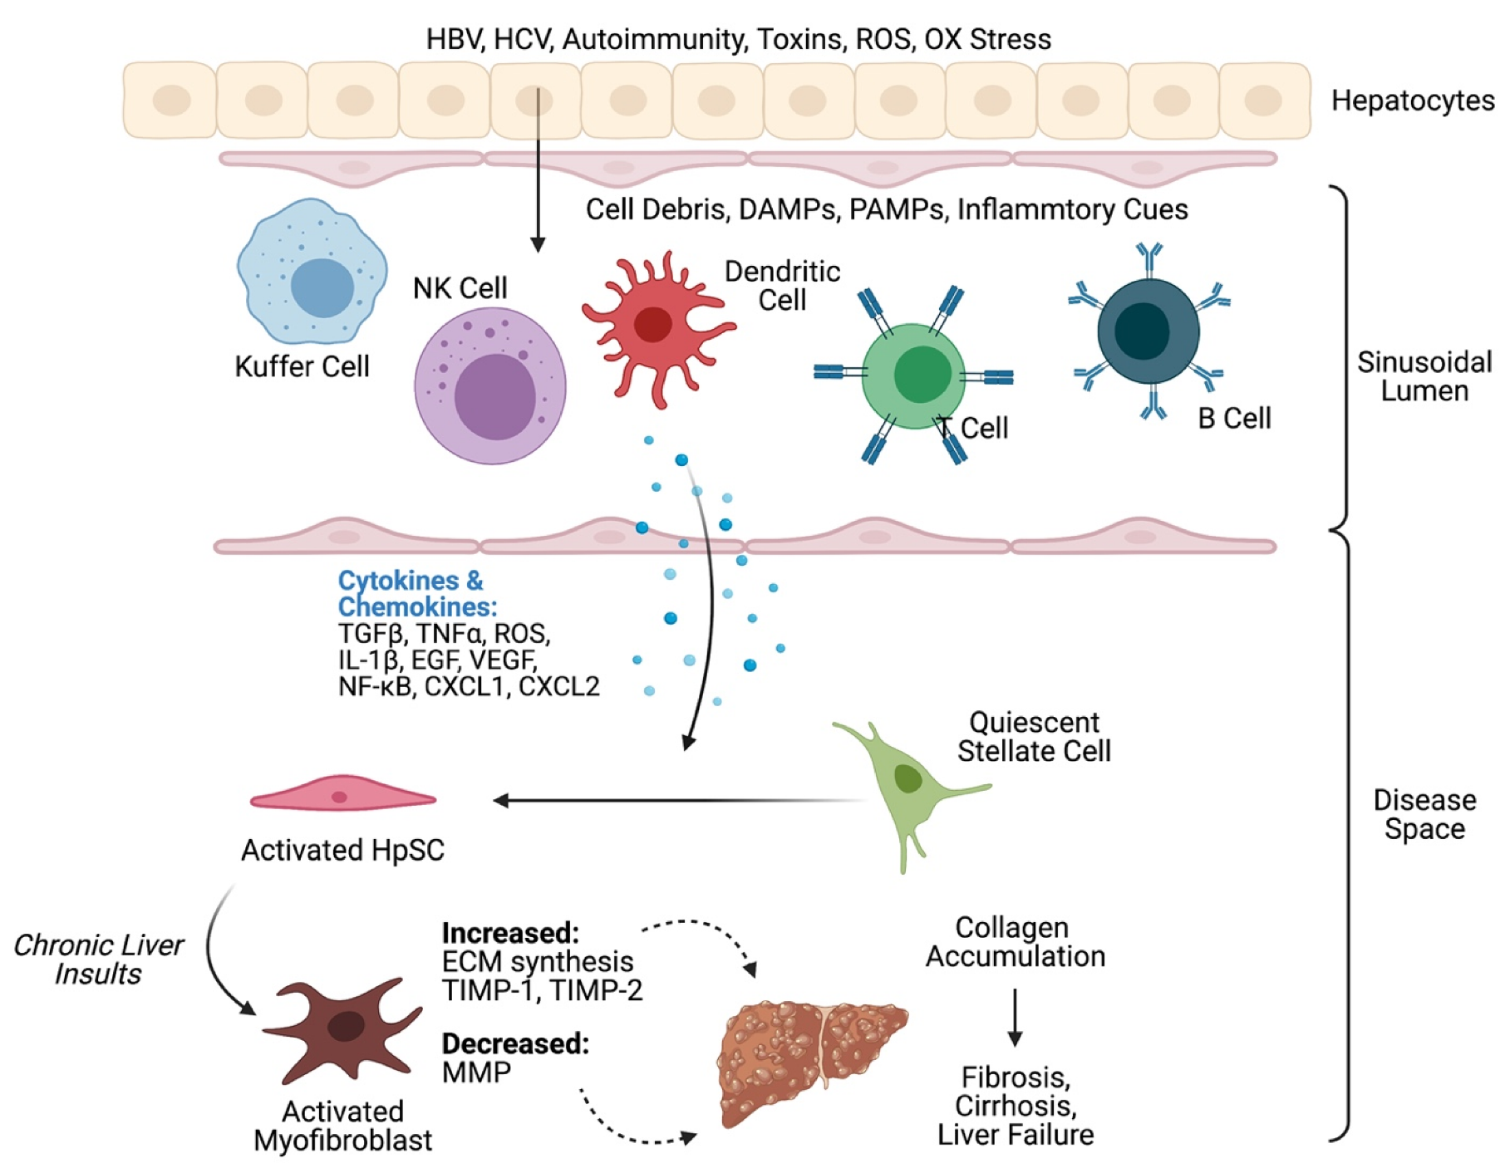
Introduction
Liver cirrhosis represents a medically significant chronic condition marked by the irreversible substitution of liver parenchyma with fibrotic tissue, resulting in progressive impairment of organ function, accompanied by structural alterations such as thickening and nodularity.
*adapted from https://www.mdpi.com/1422-0067/22/13/6777

Slide 3
Epidemiology
48%
More than six thousand cases of newly diagnosed chronic viral hepatitis are registered annually in Kazakhstan.
Of these, chronic viral hepatitis B accounts for 48%, chronic viral hepatitis C accounts for 52%.
At the same time, the highest incidence of chronic forms of viral hepatitis, about 87%, is recorded in the age group from 30 to 60 years.

Slide 4
Statistics for Kazakhstan
23,233 patients with Hepatitis C
22,977 patients with hepatitis B
1252 patients with hepatitis D
5,976 with liver cirrhosis
49175 patients (2022, WHO)
>500 people
with HCC

Slide 5
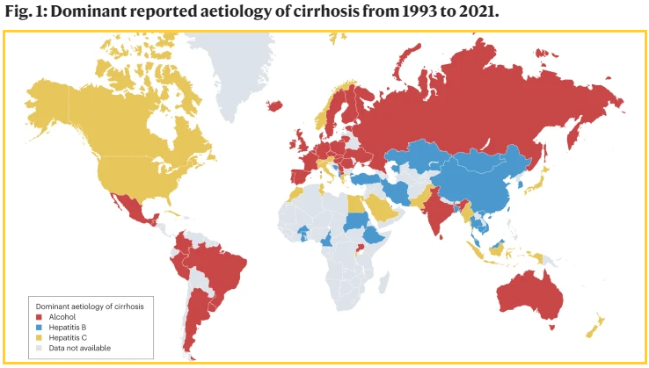
Dominant reported etiology of cirrhosis from 1993 to 2021
*Adapted from https://www.nature.com/articles/s41575-023-00759-2

Slide 6

Purpose of the Review: to analyze domestic and foreign literature concerning the diagnosis, management, and treatment strategies employed for patients afflicted with virus-induced liver cirrhosis.
Methods: We reviewed the literature from 2005–2024 to identify studies reporting perioperative outcomes in patients with cirrhosis according to surgical procedure and severity of cirrhosis. Total, we identified 87 studies, extracted study design elements, and reported perioperative outcomes by type of surgical procedure, Child-Turcotte-Pugh (CTP) class, or Model for End-stage Liver Disease (MELD) score in each.
*adapted from https://www.scholarcy.com/blog/how-to-do-an-effective-literature-review

Slide 7
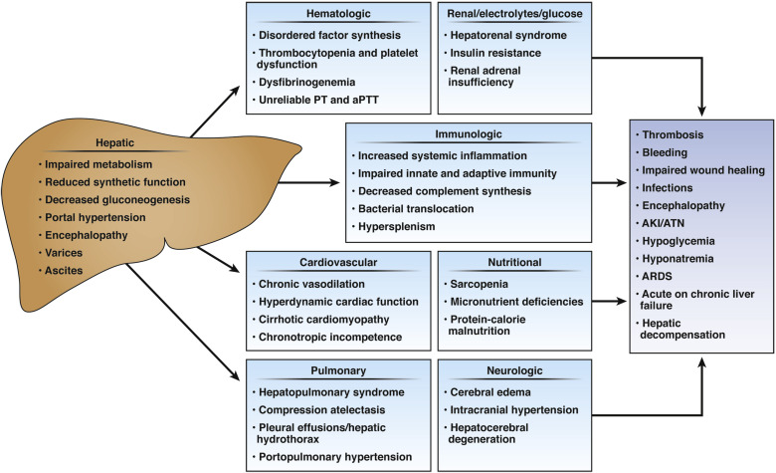
Changes in the body with liver cirrhosis
*adapted from https://www.cghjournal.org/article/S1542-3565(19)30840-7/fulltext

Slide 8
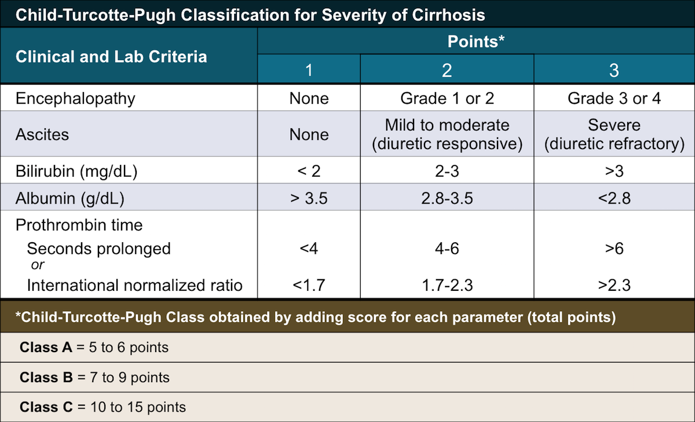
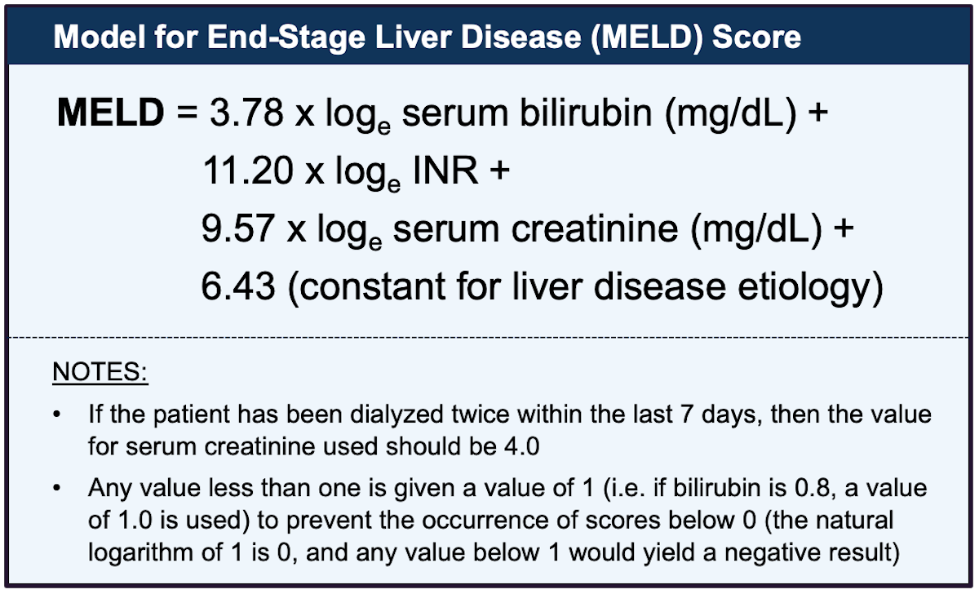
Predictors of Perioperative Mortality in Patients With Cirrhosis
Child-Turcotte-Pugh score
Model for End-Stage Liver Disease
The MELD score was developed to predict mortality in patients undergoing TIPS and is most commonly used to prioritize patients for liver transplant, but it is also predicts perioperative mortality.
Quantification of cirrhosis severity to predict surgical outcome was described by Child and Turcotte in the 1960s and modified in 1973 by Pugh et al.
*adapted from https://www.flickr.com/photos/95300616@N06/14349338664
*adapted from https://www.hepatitisc.uw.edu/pdf/evaluation-staging-monitoring/evaluation-prognosis-cirrhosis/core-concept/all

Slide 9
Results: Abdominal and gastroesophageal surgeries
Study | Surgery type | No. of patients (N) |  | Overall Mortality |  | Mortality by CTP class
 |  | Cirrhosis | No Cirrhosis (controls) | Cirrhosis | No Cirrhosis (controls) | CTP A | CTP B | CTP C
Wang, 2017 | Esophagectomy | 37 | 74 | 11% | 1% | 3% | 43% | N/A
Kim, 2017 | Gastrectomy with D2 lymphadenoctomy | 75 | N/A | 2,8% | N/A | 0% | 0% | 50%
Quillin, 2013 | Laparoscopic and open cholecystectomy | 94 | 61,711, unmatched | 4,3% | 0,2% | 3% | 0% | 100%
Hassan, 2014 | Uncomplicated umbilical hernia | 70 | N/A | 0% | N/A | 0% | 0% | 0%
Gurita, 2013 | Strangulated umbilical hernia | 12 | N/A | 0% | N/A | 0% | 0% | 0%
Banu, 2013 | Complicated umbilical hernia | 22 | N/A | 22,7% | N/A | 0% | 9% | 100%
Oh, 2011 | Inguinal hernia | 129 | N/A | 1,6% | N/A | 0% | 0% | 11%

Slide 10
Continue - Results: Lung, Cardiac and Neurosurgery
Study | Surgery type | No. of patients (N) |  | Overall Mortality |  | Mortality by CTP class
 |  | Cirrhosis | No Cirrhosis (controls) | Cirrhosis | No Cirrhosis (controls) | CTP A | CTP B | CTP C
Sabbagh, 2016 | Colorectal resection | 40 | 80, matched | 22,5% | 1,30% | 12% | 40% | N/A
Loftus, 2017 | Emergent laparotomy and temporary abdominal closure | 15 | 216, unmatched | 67% | 21% | N/A | N/A | N/A
Regimbeau, 2015 | Pancreaticoduodenectomy | 35 | 70, matched | 17% | 5% | 4% | 55% | N/A
Lin, 2014 | Cardiac surgery | 55 | N/A | 16,4% | N/A | 17% | 15% | 20%
Iwasaki, 2006 | Lung cancer surgery | 17 | N/A | 5,9% | N/A | 0% | 7,8% | N/A
Christmas, 2005 | Truama. Emergent laparotomy | 22 | 156, matched | 33% | 1% | 15% | 37% | 63%
Chen, 2018 | Neurosurgery, Craniostomy | 1233 | 2446, matched | 8,7% | 3,1% | 7,10% | 11,2% | 17,2%

Slide 11
Preoperative Evaluation and Management
Portal Hypertension
Portal hypertension may increase the liver’s susceptibility to hemodynamic changes during surgery, which can cause hepatic ischemia and decompensation
Portosystemic collaterals alter typical anatomy and may increase the risk of intraoperative bleeding.
Ascities
The presence of ascites increases the risk of peritoneal infection, ascitic fluid leak from surgical sites, and wound dehiscence in abdominal surgery.
Patients may require diuretics, salt and fluid restriction, and therapeutic paracentesis.
Encephalopathy
Encephalopathy should be controlled and ideally reversed before non-emergent surgery by using lactulose and/or rifaximin.
Serum ammonia level correlates poorly with presence of hepatic encephalopathy; thus it should not be used for diagnosis or titrating treatment
Before elective procedures, it is prudent to complete indicated screening for esophageal varices by upper endoscopy per current American Association for the Study of Liver Diseases guidelines
Optimal ascites control with nearly undetectable levels of intraabdominal free fluid is preferred before non-emergent surgery. For example, The AGA Clinical Practice Update recommends that abdominal hernia surgery be avoided unless ascites is completely controlled medically, except in cases of incarceration or suspected strangulation

Slide 12
Preoperative Evaluation and Management - continue
Coagulopathy
Cirrhosis causes alterations in prothrombotic and anticoagulant processes after even minor procedures. Cirrhotic patients have higher rates of hemorrhage and hematomas after minor invasive procedures
Trombocytopenia
A goal of >50,000 platelets/mm3 is often used for average-risk procedures,37 and experts recommend transfusion to reach this threshold.
However, Perioperative transfusion may increase intravascular pressure, worsening the complications from portal hypertension. Platelet stimulating agents may increase the platelet count but should be used with caution, because they also may increase the risk of thrombotic events
Immunologic deficiencies and inflammatory dysregulation
Patients with cirrhosis exhibit both immunologic deficiencies and an exaggerated inflammatory response. Cirrhosis leads to decreased synthesis of important proteins needed for innate immune response, cytopenia, and impaired cellular responses.
There is also increased systemic inflammation secondary to translocation of bacteria and bacterial products because of gut barrier dysfunction and dysbiosis
There is an uncertain role for vitamin K, fresh frozen plasma, factor VIIA, and cryoprecipitate to treat coagulopathy preoperatively in cirrhotic patients.

Slide 13
Postoperative Management
Encephalopathy
For patients at increased risk of encephalopathy due to severity of cirrhosis or history of encephalopathy, bowel movements should be monitored, and lactulose should be administered if needed, aiming for 2–4 per day. Dietary protein intake should not be restricted.
Volume status
Renal function should be monitored daily. For patients on chronic diuretics, these can be restarted after surgery if the patient is stable, can take oral medications, and has preserved renal function. Judicious fluid and electrolyte management is also essential to avoid accumulation of ascites or edema while maintaining adequate intravascular volume to perfuse the kidneys.
Postoperative spontaneous bacterial peritonitis
Patients on prophylactic antibiotics for SBP should continue them postoperatively. Current guidelines do not cover the evaluation of postoperative SBP in individuals who have undergone intra-abdominal surgery. Cell count–based thresholds for diagnosis may be confounded by postoperative inflammatory changes.
Pain Management
Analgesia is notoriously challenging in patients with cirrhosis. Nonsteroidal antiinflammatory drugs should be avoided because of the risk of GI bleeding and renal toxicity. In patients not using alcohol, acetaminophen may be safely used at total daily dose
Venous thromboembolism prophylaxis
Cirrhotic patients are at risk of venous thromboembolism (VTE) prophylaxis postoperatively, especially after orthopedic surgery or if immobilized. Importantly, the presence of coagulation abnormalities in INR or platelet count does not protect patients.

Slide 14
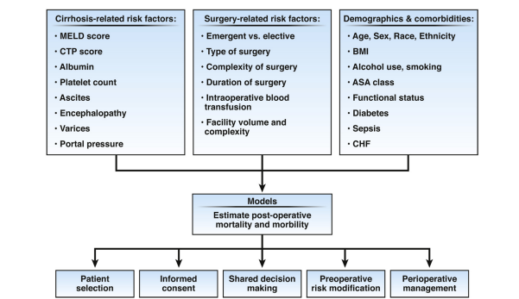
Model for predicting postoperative mortality
*adapted from https://www.cghjournal.org/article/S1542-3565(19)30840-7/fulltext

Slide 15
Conclusion
In general, patients with cirrhosis exhibit perioperative mortality rates that are five–six times higher than those without cirrhosis, with variations depending on the extent of liver dysfunction.
Patients with compensated cirrhosis (CTP class A or MELD <10) and few comorbidities generally tolerate surgery well.
Risks and benefits of elective surgery should be weighed for CTP class B patients (MELD 11–15); preoperative optimization and perioperative monitoring are essential for this moderate-risk group.
CTP class C patients (MELD >15) are at high risk for mortality; liver transplantation or alternatives to surgery should be considered.

Slide 16


Acknowledgments
Al-Farabi Kazakh National University
Local supervisor: Anna Shin, PhD, MD
Gaukhar Kurmanova, Doctor of Medical Sciences, Professor
First Moscow State Medical University named after I.M. Sechenov
Mikhail Kostinov, Doctor of Medical Sciences, Professor

Slide 17
Thank you for your attention

